Slide 1
E-SAMPLING
ROUGE DIOR
JAN 2021

Slide 2
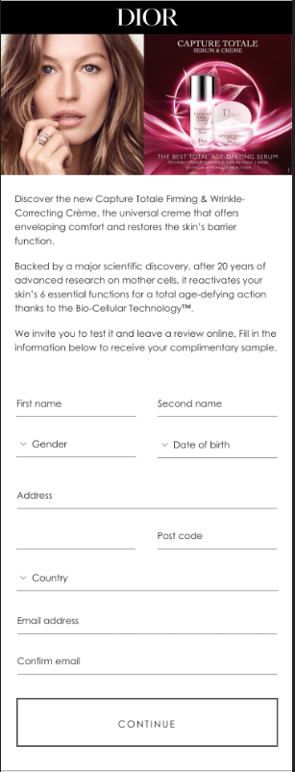


INTERFACE – ALL MARKETS
Please change DIOR banner to white with black logo
Replace Capture Total visual with Rouge Dior visual
Please replace text with the below (keep the text below the red line):
More modern and luxurious than ever, discover the new Rouge Dior.
Rouge Dior dresses the lips in 75 bold colors with satin, matte, metallic or velvet finishes. Long-wear lipstick that ensures 16 hour of comfort on the lips.
Rouge Dior lipstick is part of the House of Dior’s sustanability strategy and is now refillable.
Please insert ‘City’ here

Slide 3
INTERFACE – ELLE
Change DIOR banner to white with black logo
Replace Capture Total visual with Rouge Dior visual
Please replace text with the below:
Exclusively for ELLE readers, Dior invites you to test the new Rouge Dior lipstick and review the product at your preferred webshop. Fill in the information below to receive your complimentary sample.
More modern and luxurious than ever, discover the new Rouge Dior.
Rouge Dior dresses the lips in 75 bold colors with satin, matte, metallic or velvet finishes. Long-wear lipstick that ensures 16 hour of comfort on the lips.
Rouge Dior lipstick is part of the House of Dior’s sustanability strategy and is now refillable.
Please insert ‘City’ here

Slide 4
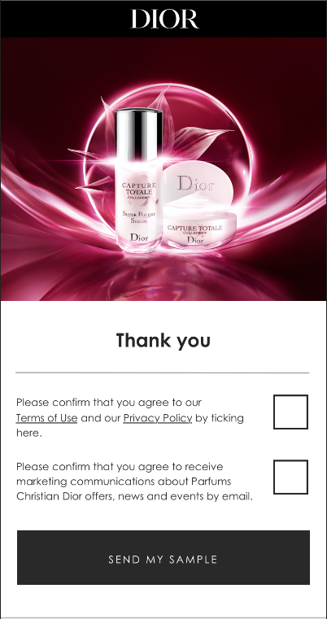

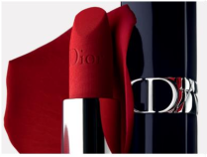
INTERFACE – ALL MARKETS
Change DIOR banner to white with black logo
Replace Capture Total visual with Rouge Dior visual
Use the same T&Cs text

Slide 5
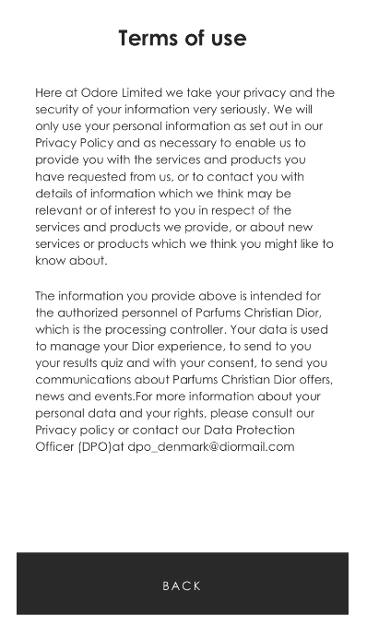
TERMS & CONDITIONS
Use the same Terms of use as used for Capture Totale

Slide 6
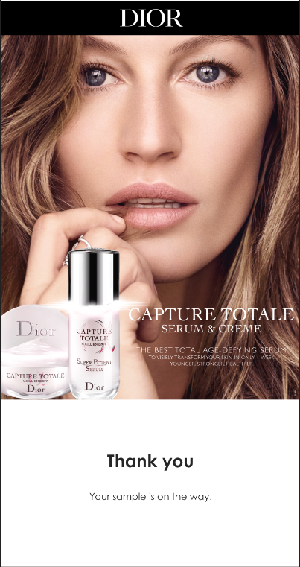

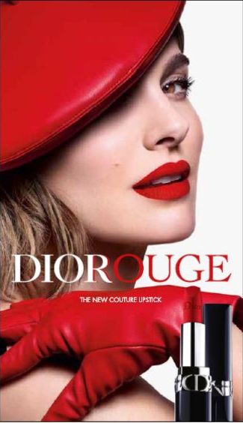
THANK YOU PAGE
Change DIOR banner to white with black logo
Update Capture Total visual with Rouge Dior visual
Keep the same text

Slide 7
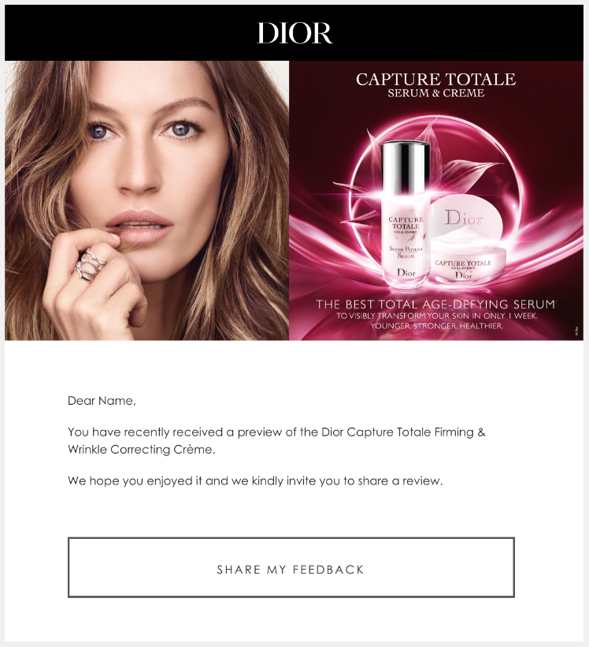

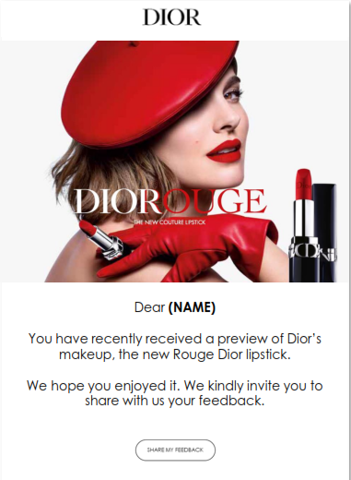
RECALL EMAIL
Change DIOR banner to white with black logo
Replace Capture Total visual and text with Rouge Dior visual and text

Slide 8
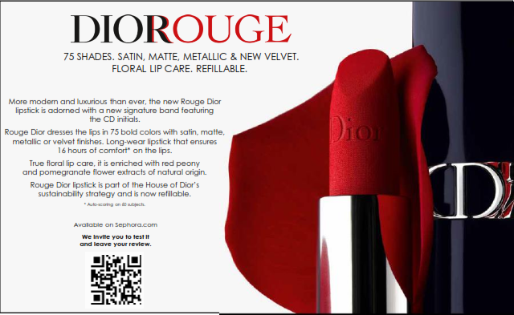

SAMPLING CARD
Please use the text above but insert this sentence: “We invite you to test it and leave your review at your preferred webshop.” instead of “Available on Sephora.com”
Kindly remove the QR code and text.

